Slide 1
stock closing price prediction using matching learning
Group name：stock market prediction
Group member：
110368019陳俊成 110368151呂彥旻 110658020黃伯洋 110658041鄧宇傑
Video Link : https://youtu.be/hqi7OChZM9A

Slide 2
Outline
Introduction to stock forecasts
Introduction to home work model
Production results
Conclusion
References
Notes:
本次報告重點

Slide 3
Introduction to stock forecasts
Stock trading is now the mainstream investment method; with the operation of the market industry chain, stock market analysis has always been regarded as a very hot topic.
What we can know is that each type of industry will belong to its peak season and low season. We can follow the logic of the past and use deep learning to predict the future of the stock market.

Slide 4
Introduction to stock forecasts (Cont'd)
If we can make judgments based on past closing prices and industry chain cycles, we have the opportunity to make models judge future stock prices. We hope that through deep learning, the data produced can be a simple model with an error value within ±5% to show the future direction of the stock market.

Slide 5
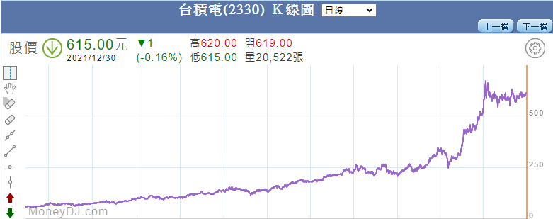
TSMC's historical trend
Take TSMC (2330) as an example, look at the closing price from July to December of each year.

Slide 6
TSMC‘s historical trend (Cont'd)
Data | Closing price | Data | Closing price
2010/7/2 | 60.3 | 2016/7/7 | 164.5
2010/12/3 | 68.3 | 2016/12/2 | 178.1
2011/7/8 | 72.5 | 2017/6/30 | 208.5
2011/12/2 | 76 | 2017/12/1 | 231
2012/7/6 | 80.9 | 2018/6/29 | 216.5
2012/12/7 | 98.1 | 2018/12/7 | 221
2013/7/5 | 109 | 2019/7/5 | 243
2013/12/6 | 103 | 2019/12/6 | 313
2014/7/4 | 135 | 2020/7/5 | 329.5
2014/12/5 | 137.5 | 2020/12/4 | 504
2015/7/9 | 136.5 | 2021/7/2 | 589
2015/12/4 | 140.5 | 2021/12/3 | 608
Notes:
As we can see, take July to December of each month as an example.
Since it is the beginning and end of the peak season, it can be seen that in early DecemberMost closing prices are rising.
IN the TSMC sheet we can see there is only one season is green so for the peak season this will be a good date to training and predict

Slide 7
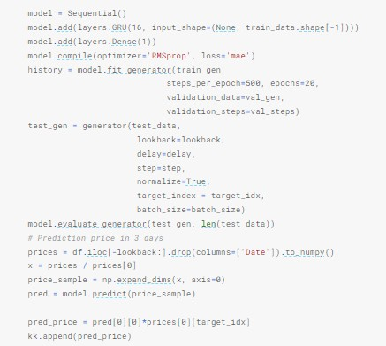
Introduction to home work model
In the homework, the teacher uses Gated RNN-GRU to edit the program.
Notes:
Here Im going to compare the example from teacher and our work ， first sample from teacher are using 16 floors GRU and a dense and our is using 256 floors LSTM and a dense

Slide 8
Introduction to home work model (Cont'd)
The result of using GRU to judge is quite close.
Estimated value
Actual value

Slide 9

Introduction to home work model (Cont'd)
But if GRU is used to predict the closing price of 2 weeks, the error will become larger.
Estimated value
Actual value

Slide 10

Question discussion
If we want to make long-term investments and evaluate the stock market from the perspective of monthly or quarterly lines, what methods can achieve the results we want?

Slide 11
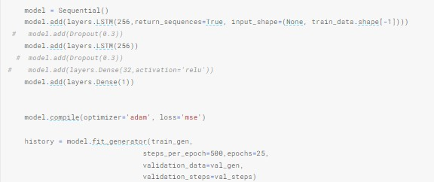
Production results
We changed the content of the assignment, used the LSTM model, and adjusted the training parameters to complete this challenge.
Ps. We use Taiwan Stocks 0050 to experiment
Notes:
Supplement: We will replace the GRU model with LSTM for testing.

Slide 12
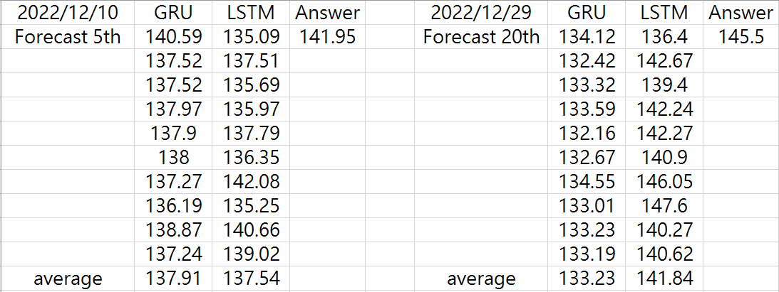
Production results (Cont'd)
Notes:
We can see that according to the forecast results after 5 days,
GRU is closer to the actual data.
But when we switch to the 20-day result, LSTM is closer to the actual result than GRU
Let see the average box when the date result is short the GRU will be better but when the database is large LSTM will be better

Slide 13
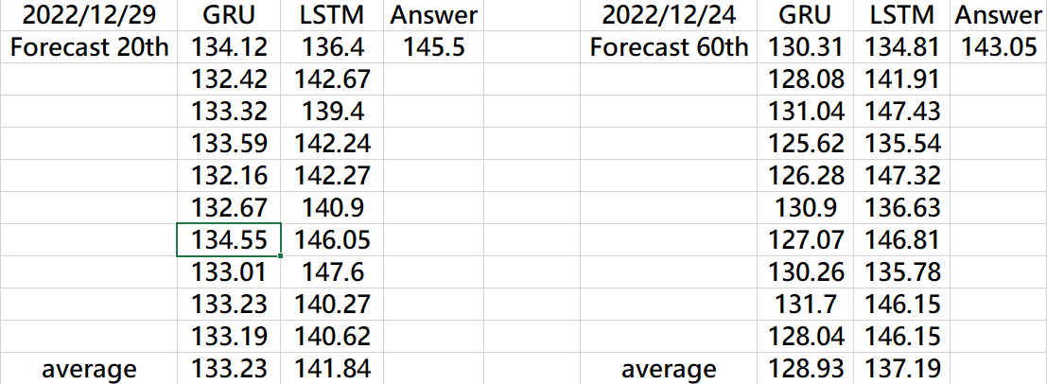
Production results (Cont'd)
Notes:
Let’s take a look at the results on the 20th and 60th.
It can be found that the effect of LSTM is better than that of GRU.

Slide 14
LSTM
Long Short Term Memory is a special RNN that can learn long-term sequences.
LSTM uses a total of three gates as input gates, forget gates, and output gates.
Input Gate: Decide which messages need to be stored in long-term memory.
Forget Gate: The forget decides which information in long-term memory is retained or discarded.
Output Gate: Use previous data to calculate new short-term memory.
Notes:
Input Gate
The input gate decides what information will be stored in long term memory. It only works with the information from the current input and short term memory from the previous step. At this gate, it filters out the information from variables that are not useful.
Forget Gate
The forget decides which information from long term memory be kept or discarded and this is done by multiplying the incoming long term memory by a forget vector generated by the current input and incoming short memory.
Output Gate
The output gate will take the current input, the previous short term memory and newly computed long term memory to produce new short term memory which will be passed on to the cell in the next time step. The output of the current time step can also be drawn from this hidden state.
And why we need dose gate?
RNN is limited by short-term memory. If a sequence is long enough, its difficult for them to transfer information from an earlier time step to a later time step. SO RNN may miss important information at the beginning

Slide 15
GRU vs. LSTM
What is the difference between GRU & LSTM?
The GRU has two gates, LSTM has three gates.
GRU doesn’t possess any internal memory, they don’t have an output gate that is present in LSTM.
LSTM is suitable for long-term memory data operations. GRU is a fast-improved version of LSTM.
Notes:
The first supplement: As mentioned earlier, LSTM has input gates, forget gates and output gates, GRU update gates and recovery gates.
The third point is added: GRU is a fast improved version of LSTM. When we ran the experimental results, we clearly felt that GRU is approximately 1.25 times faster than LSTM.
But the information we inquired shows that the two are used in different places, just like the estimated long-term stock market data this time.

Slide 16
Conclusion
GRU can use fewer training parameters, so it uses less memory and is faster to execute than LSTM, while LSTM is more accurate on large data sets.
If we deal with large sequences and care about accuracy, we can consider LSTM.
Notes:
GRU uses less training parameter and therefore uses less memory and executes faster than LSTM whereas LSTM is more accurate on a larger dataset. One can choose LSTM if we are dealing with large sequences and accuracy is concerned,
GRU is used when we have less memory consumption and want faster results.

Slide 17
References
https://analyticsindiamag.com/lstm-vs-gru-in-recurrent-neural-network-a-comparative-study/
https://tengyuanchang.medium.com/%E6%AF%94%E8%BC%83%E9%95%B7%E7%9F%AD%E6%9C%9F%E8%A8%98%E6%86%B6%E6%A8%A1%E5%9E%8B-lstm-%E8%88%87%E6%94%B9%E8%89%AF%E5%BE%8C%E7%9A%84%E9%81%9E%E6%AD%B8%E7%A5%9E%E7%B6%93%E7%B6%B2%E8%B7%AF%E6%A8%A1%E5%9E%8B-gru-813dec22ec6d
https://brohrer.mcknote.com/zh-Hant/how_machine_learning_works/how_rnns_lstm_work.html
https://zhuanlan.zhihu.com/p/32085405

